Slide 1

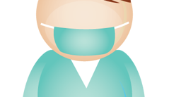
NOTICE
MARIKINA ORTHOPEDIC SPECIALTY CLINIC (MOSC):
NO FACE MASK,
NO ENTRY
NO HELMET
NO VIDEO CALLS

